Slide 1

Artificial Intelligence for Business Decisions and Transformation
CSCN8030 - Spring 2024 - Section 2
Sprint 6 - Design
July 29, 2024
Group 4 - Members:
Krishna Kumar, Hemasree
Shijin, Jency
Fernandez, Arcadio
Professor:
Glaucia Melo dos Santos, PhD

Slide 2
Agenda
1. Group members role
2. Problem Statement
3. Dataset
4. Project Pitch
5. Sprint Planning

Slide 3
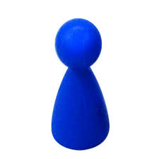
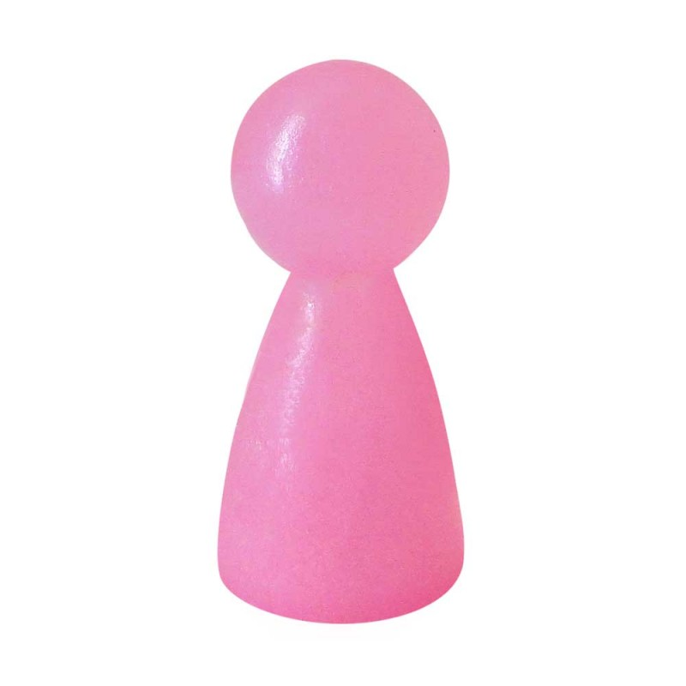
1. Group members role
Product owner
Developers
Jency
Arcadio
Hema
Connects with the customer
Contributes to the vision and roadmap
Manages and prioritizes the team backlog
Supports the team in delivering value
Continuously evolves product design
Implements the vision and roadmap
Works on the team backlog
Builds, tests, and delivers increments of value

Slide 4
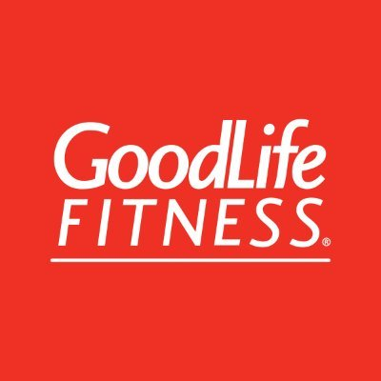
2. Problem Statements
1. Optimizing Group Fitness Class Utilization
Objective: Increase the number of available spaces for fitness classes by predicting member attendance and reallocating spaces from predicted absences.
Techniques: Predictive modeling, Logistic regression, Decision trees, Random Forest
Outcome: Higher utilization rate of fitness class spaces, reduced class wait times, and improved member satisfaction due to better space management
2. Optimizing Gym Equipment Utilization
Objective: Estimate the number of people using the gym at different times of day to maximize equipment availability and promote use.
Techniques: Feature selection techniques, Feature engineering, predictive analytics, Regression techniques
Outcome: Accurate predictions of gym crowd levels, which allows for better scheduling and improved equipment availability during peak times.

Slide 5
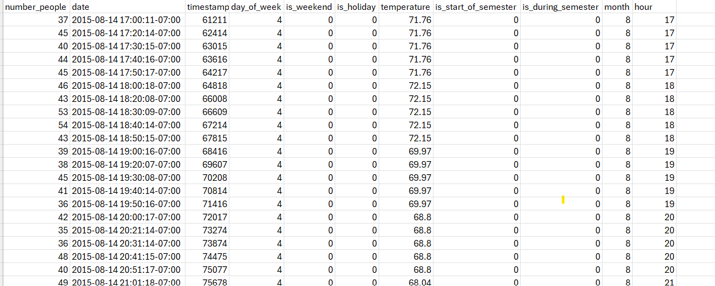
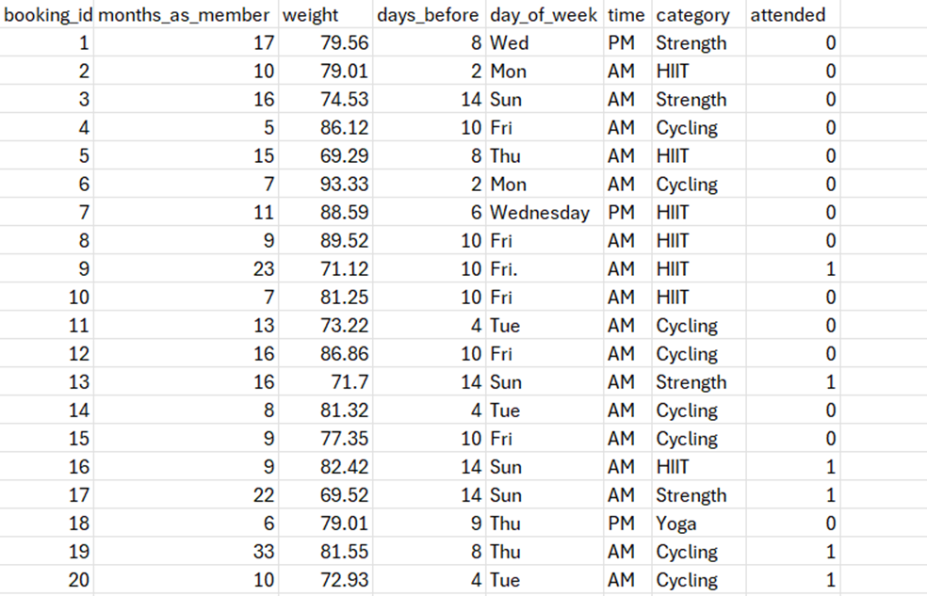
3. Analyzing the Dataset
Gym Crowd Level data
Member Class Booking data
1500 records about members attending different classes
26,000 people counts (about every 10 minutes) over the last year. Total rows - 62184

Slide 6
5. Project Pitch
AI-Driven User Interest Profiling based on TikTok Reviews
Project Pitch | BUSINESS
Organization or Category | GoodLife Fitness
Description of Organization | GoodLife Fitness is one of Canada's largest fitness chains, boasting over 450 locations nationwide. It offers a diverse range of services including group fitness classes, personal training, and state-of-the-art gym equipment. Known for its inclusive and supportive environment, GoodLife Fitness emphasizes accessibility and community engagement, leveraging technology like a mobile app and virtual classes to enhance the member experience. The organization is committed to improving health and wellness through innovative programs and active community involvement.
Two Specific Ethical Considerations in AI Adoption

Slide 7
5. Project Pitch
AI-Driven User Interest Profiling based on TikTok Reviews
Three Examples of Operational Decisions
Three Examples of Tactical Decisions

Slide 8
5. Project Pitch
AI-Driven User Interest Profiling based on TikTok Reviews
Three Examples of Strategic Decisions

Slide 9
5. Project Pitch
AI-Driven User Interest Profiling based on TikTok Reviews
Why this is topic important?
How could this project make an impact outside of class?
Why should class choose this topic?

Slide 10
6. Sprint Planning
Tasks | Owner | Priority | Sprint | Story Points | Estimated Effort in Hours
Perform Data integration by merging TikTok public user profiles and user reviews data by identifying common keys or fields. | Hema | med | 6 | 3 | 1
Clean the data by handling missing values, correcting data types, and ensuring data consistency. | Hema | med | 6 | 3 | 1
Explore the dataset to understand its structure, features, and distributions to gain insights into engagement patterns, identify trends or user interests | Hema | High | 6 | 5 | 1
Preprocess the user reviews or any other text data by cleaning, tokenizing, lemmatizing, and removing stop words. | Hema | High | 6 | 5 | 2
Convert the preprocessed text data into numerical representations using text embeddings such as BERT, FastText, or TF-IDF. | Jency | Med | 6 | 3 | 1
Utilize pre-trained models for text classification, such as BERT fine-tuned with Hugging Face’s Transformers library, to annotate user reviews into predefined interest profiles | Jency | Med | 6 | 3 | 1
Choose appropriate ML algorithms based on business objectives | Jency | Med | 6 | 3 | 1
Train and Fine-tune the selected models using a labeled dataset for specific interest profiles. | Arcadio | High | 6 | 5 | 2
Evaluate the model performance using metrics like accuracy, precision, recall, and F1-score. | Arcadio | High | 6 | 5 | 2
Interpret the user interest profiling results to identify trending topics and areas of user interest and preferences. | Arcadio | High | 6 | 3 | 3

Slide 11
Thank you
Any Questions

